Slide 1
An Evaluation of Machine Translation for Multilingual
Mental Health Detection
Flavius Stan (506)
Anca Iordachescu (507)

Slide 2
Starting point
The main paper: An Evaluation of Machine Translation for Multilingual Sentence-level Sentiment Analysis
Gathering 9 Sentiment Analysis different language datasets and translate them into English using Google Translate
Gathering 21 existing Sentiment Analysis English systems and test them on the translated datasets
Compare the results of the English systems with each native method for each language

Slide 3
Motivation & Introduction
The main objective is detecting mental health using online social networks
Much of the research on this theme has been done on English datasets
Datasets in other languages are hard to find because of the language barriers and and strict privacy policies of collecting mental health data
We want to make an evaluation of Machine Translation on Multilingual mental health detection
We gathered data from four non-English languages: Japanese, Korean, Spanish, Russian, then developed language-specific models for each one and implemented and tested 3 different English methods on the translated text to English
Finally, we compare the results obtained by all models

Slide 4
Datasets
Language | # Texts | Train | Test
 |  |  | # Pos | # Neg
Korean | 1000 | 900 | 50 | 50
Japanese | 1000 | 900 | 50 | 50
Russian | 63500 | 63400 | 50 | 50
Spanish | 10100 | 10000 | 50 | 50

Slide 5
Machine Translation Systems
Google Translate:
is the most used free online translation service, having a coverage of approximately 133 languages
we worked with this system by using Googletrans, a Python library which implements Google Translate API
Helsinki-OPUS-MT:
is a machine translation system developed by the Natural Language Processing and Language Technology group of University of Helsinki
In order to make the translation from our specific languages to English using OPUS-MT, we used the next models found on HuggingFace

Slide 6
English Mental Health Detection Systems
System | Dataset | Description Dataset | Output | Model | Accuracy
System1 | Suicide and Depression Detection | Posts collected from Reddit that expresses signs of suicide/severe depression or non-depression | 0, 1 | Fine-tuning google/electra-base-generator | 97%
System2 | Mental Illness Disorder Detection | Posts collected from Reddit, each one being associated with one of 5 mental illnesses or none | depression, anxiety, ptsd, adhd, bipolar, none | Fine-tuning roberta-base | 85%
System3 | Dreddit | Posts collected from Reddit that shows signs of interpersonal conflict/mental illness or none | 0, 1 | Fine-tuning mental/mental-bert-base-uncased | 80%

Slide 7
Language-specific Mental Health Detection System
Language | Model | Accuracy
Korean | Fine-tuning bert-kor-base transformer | 80%
Japanese | Fine-tuning bert-base-japanese transformer | 90%
Russian | Fine-tuning bert-base-japanese transformer | 92%
Spanish | Fine-tuning dccuchile/bert-base-spanish-wwm-cased transformer | 73%

Slide 8
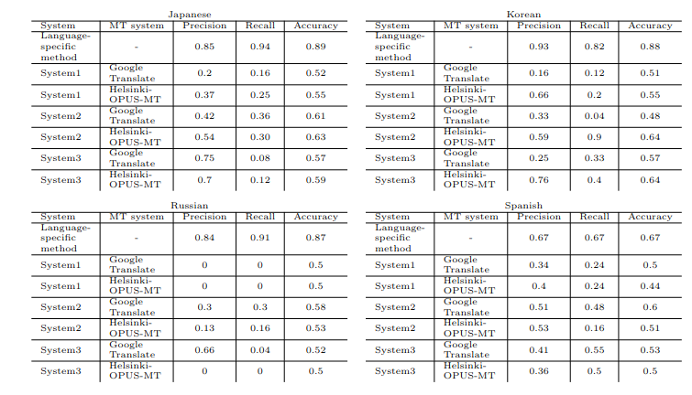
Results

Slide 9
Observations
The language-specific methods perform better than the English ones that were applied on the translated datasets. However, this result may be affected by the fact that both the training and testing data were collected by the same people.
The texts that were translated using Helsinki-OPUS-MT produced better performance for the English models than the ones being translated using the Google Translate for the Korean and Japanese datasets.
For the Russian and Spanish datasets the Google Translate worked better.
The System1 approach didn’t perform well
System2 was able to detect better the mental health signs as it was trained to predict either none, or one of five types of mental health
System3 couldn’t predict suitable labels, our intuition being the fact that it was trained on few data

Slide 10
Limitations
The lack of data has limited the purpose of our research because we have found only one dataset for each non-English language
Each non-English language dataset was split for being used for both training and test steps.
We couldn’t evaluate the translation of non-English texts to English using the Machine Translation systems because we didn’t have any ground truth to datasets and couldn’t compute, for example, the BLUE score to establish which MT system works better

Slide 11
Conclusions
More and more research is being done on the subject of mental health detection using online social network platforms
Because most of the mental health detection models are designed on English datasets, it is crucial to discover new methods or techniques in order to make it available for non-English languages.
In this work, we provide an evaluation of Machine Translation for Multilingual Mental Health Detection
Our results suggest that better performance has been achieved on the language-specific methods than the English ones
Another important observation is that the Japanese and Korean datasets which were translated with Helsinki-OPUS-MT had better performance than the ones translated with Google Translate

Slide 12
Future Work
Experiments are expected to be carried out on larger and more datasets to establish if this approach is a powerful strategy instead of training a native model for each language.
Employ human experts to annotate the non-English datasets in order to compare the Machine Translation systems used.

Slide 13

Thank you!
however, we have worked hard on this project :)

